Slide 1

CHRISTU JYOTHI INSTITUTE Of TECHNOLOGY AND SCIENCE (NBA Accredited, Affiliated to JNTUH University) Colombo Nagar, Yeshwanthpur, Jangaon, Telangana, 506167 Department of Electrical & Electronics Engineering 2023-24 A MINI PROJECT PRESENTATION ON ARUDINO BASED SOLAR TRACKING
Under the esteemed guidance of Y. VIJAY JAWAHAR PAUL
Presented by
K.POOJITHA - 21681A0208
B. PURNACHANDER - 22685A0202
S.AJAY - 22685A0213
A.SATHWIKA - 21681A0215

Slide 2
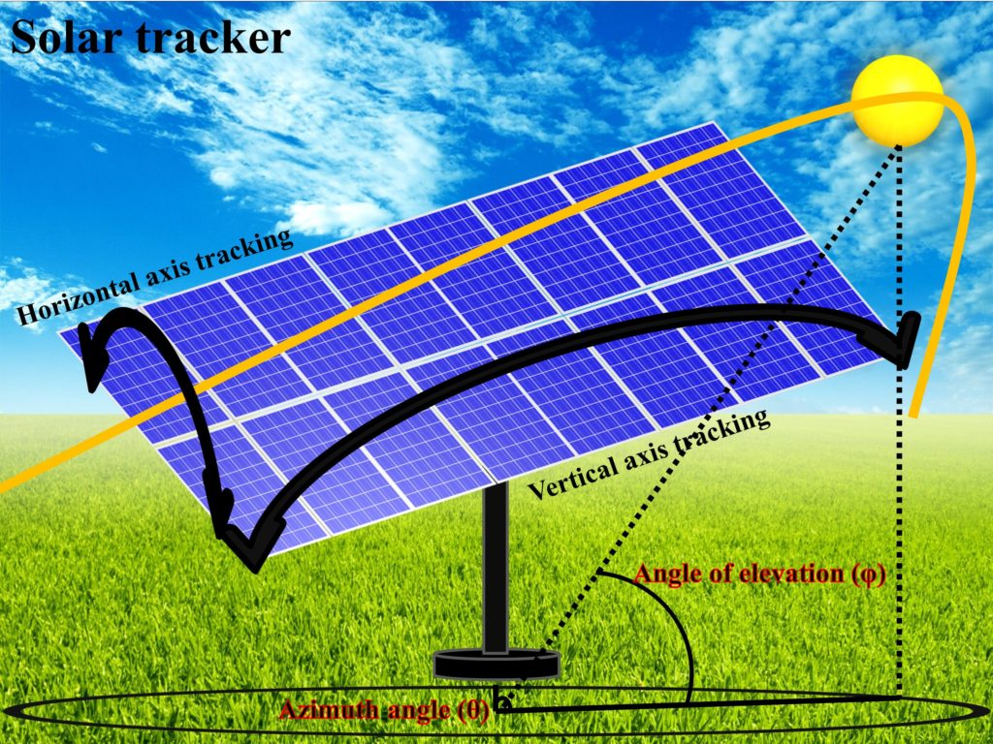
ARUDINO BASED SOLAR TRACKING

Slide 3
ABSTRACT
This project presents an innovative Arduino-based solar tracking system designed to optimize energy harvesting from solar panels. The system utilizes Light Dependent Resistors (LDRs) to detect the sun’s intensity and direction, and gear motors to adjust the solar panel’s angle accordingly. By leveraging real-time sun tracking and adjustment, this cost-effective solution maximizes solar panel performance, enhancing energy efficiency and promoting sustainable energy practices. The Arduino-based solar tracking system offers a reliable and efficient solution for renewable energy applications. With its advanced algorithms and sensor technologies, the system provides real-time tracking and adjustment, resulting in increased energy output and reduced carbon emissions. This presentation will delve into the design, development, and implementation of the system, highlighting its benefits and potential for widespread adoption in the pursuit of sustainable energy solutions.

Slide 4
CONTENTS
INTRODUCTION
OBJECTIVE
BLOCK DIAGRAM
HARDWARE REQUIREMENT
WORKING PRINCIPLE
ADVANTAGES
DISADVATAGES
APPLICATIONS
CONCLUSION
FUTURE SCOPE

Slide 5
INTRODUCTION
Utilizes IOT for dynamic alignment of solar panels with the sun’s position.
Renewable energy solutions are becoming popular.
IOT integrates sensors & connectivity into solar systems for enhanced monitoring & control.
Solar tracking system has 35% higher generating power than fixed.

Slide 6
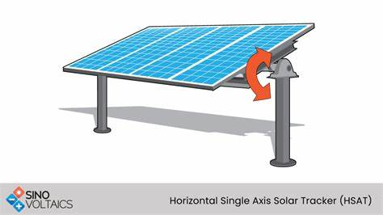
What is solar tracker ?
A solar tracker is a device that orients the PV panels toward the sun throughout the day ensuring that the maximum amount of sunlight strikes the panel. Solar trackers are positioned and attached to solar panels

Slide 7
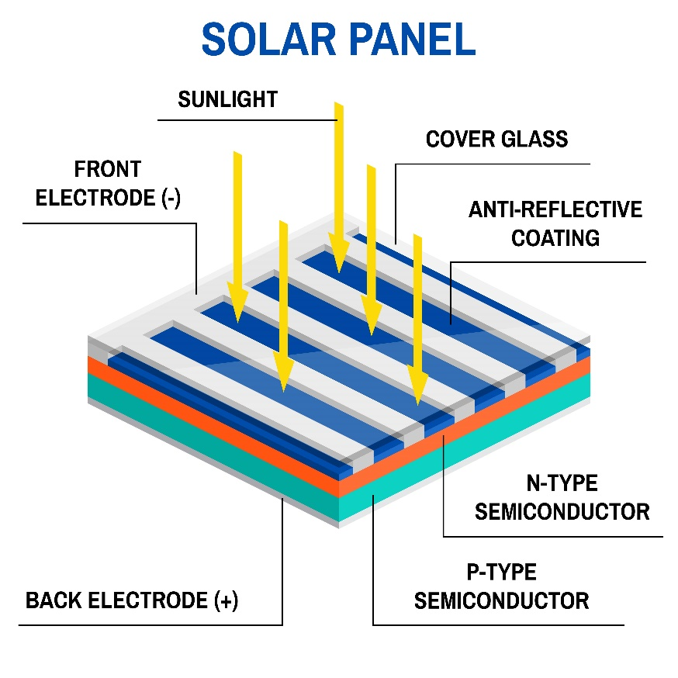
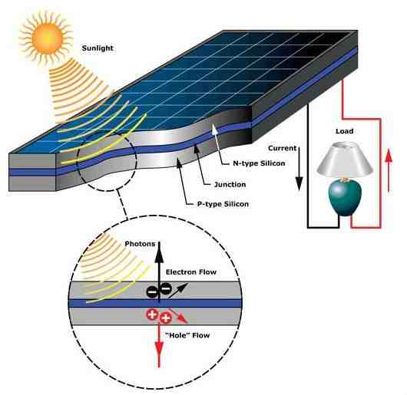
WORKING OF SOLAR CELL

Slide 8
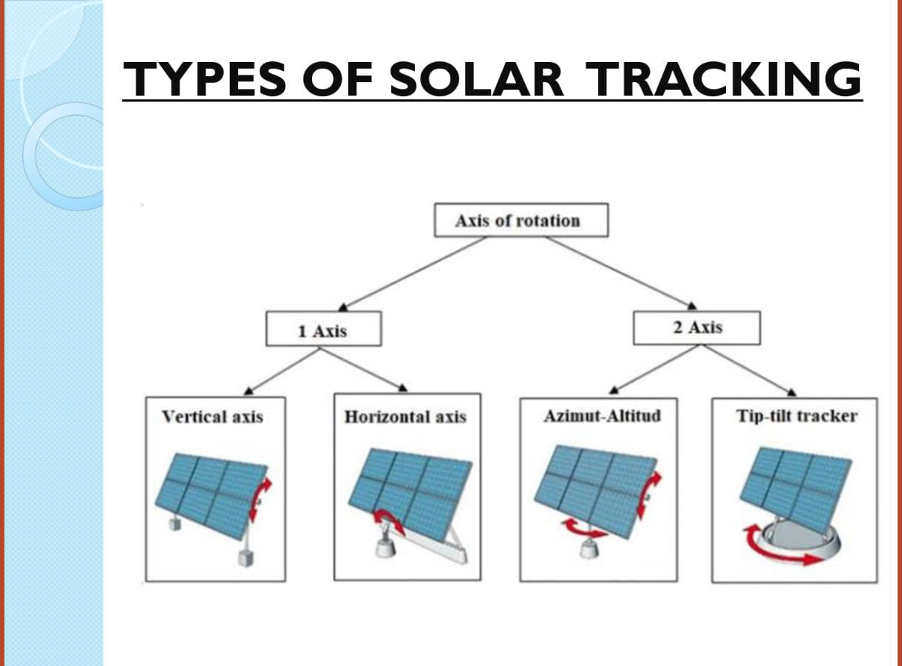

Slide 9
OBJECTIVE
Maximize solar energy harvesting
Optimize solar panel angle and orientation
Increase energy output by 20-40%
Reduce energy waste and losses
Improve system efficiency and performance
Automate solar panel tracking

Slide 10
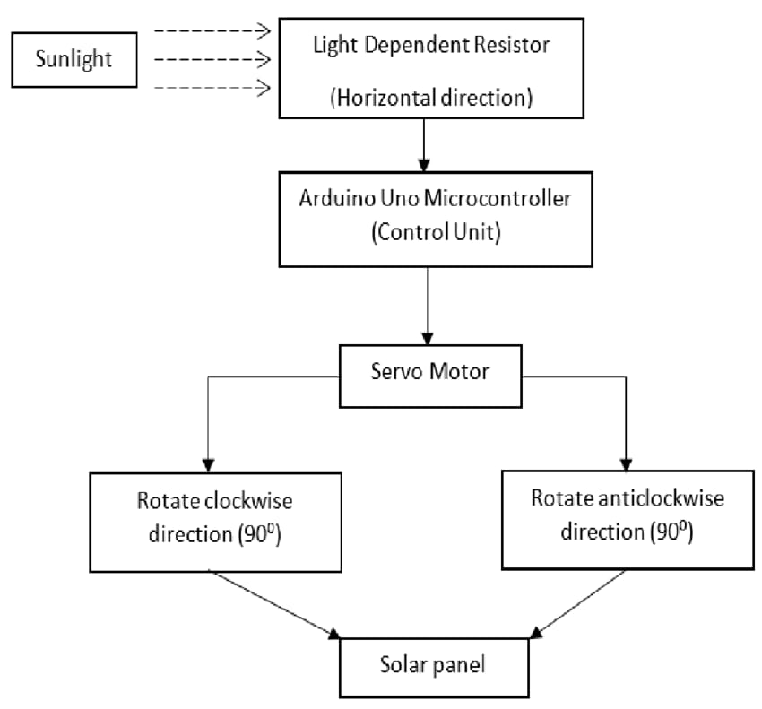
BLOCK DIAGRAM

Slide 11
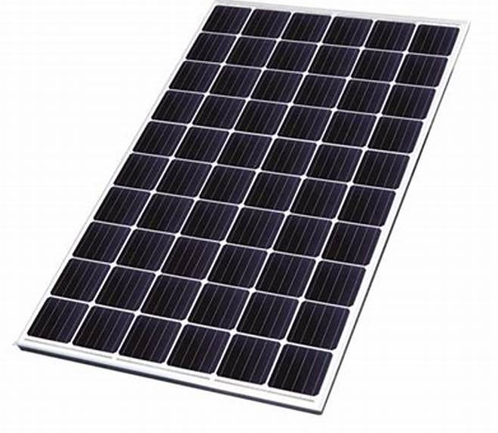
HARDWARE REQUIREMENT
ARDUINO NANO
SOLAR PANEL
LDR SENSOR
GEAR MOTOR
L293 MOTOR DRIVER MODULE
JUMPER WIRES
ADAPTER

Slide 12
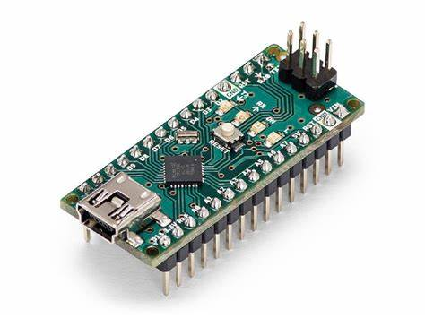
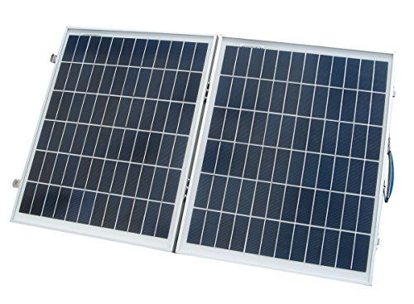
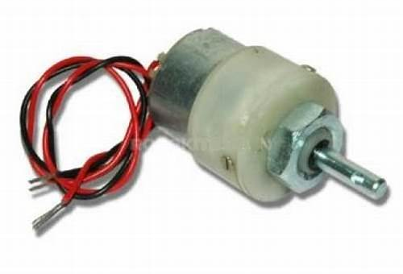
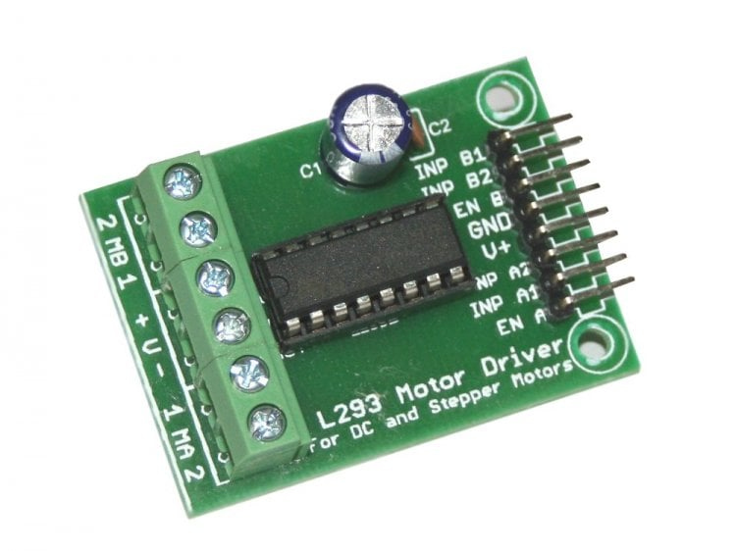
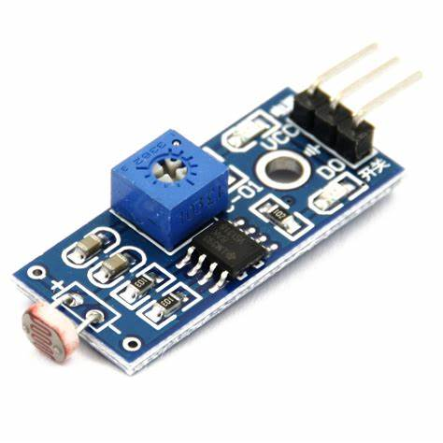
COMPONENTS
ARDUINO NANO SOLAR PANEL GEAR MOTOR
L293 MOTOR DRIVER LDR SENSOR

Slide 13
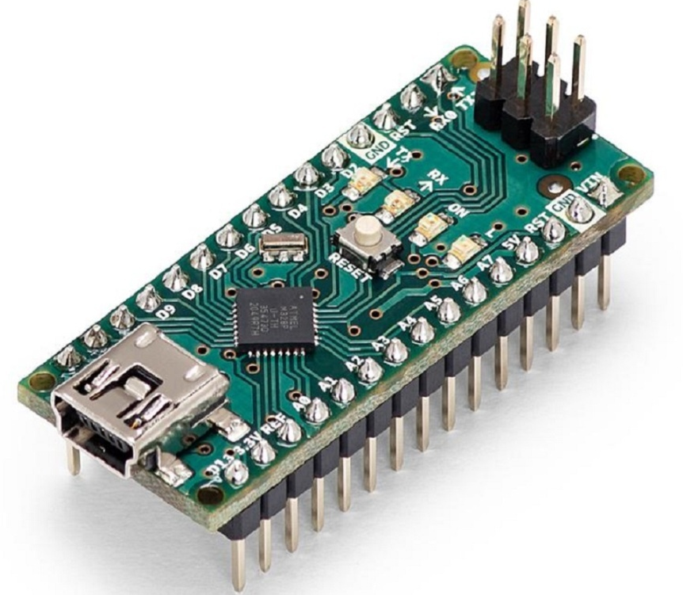
ARDUINO NANO
Microcontroller : ATmega328P
Operating voltage : 5V
Input voltage : 5 to 20V
Digital I/O pins : 14
Analog input pins : 8
DC per I/O pin : 40 Ma
DC for 3.3V pin : 50 mA

Slide 14
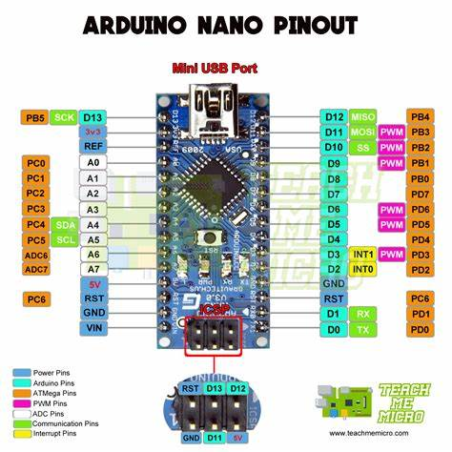

Slide 15

LDR SENSOR
Can detect ambient brightness and light intensity
Output Digital – 0V to 5V, Adjustable trigger level from preset
Output Analog – 0V to 5V based on light falling on the LDR
Adjustable sensitivity
PINS : Vcc , GND & O/P

Slide 16
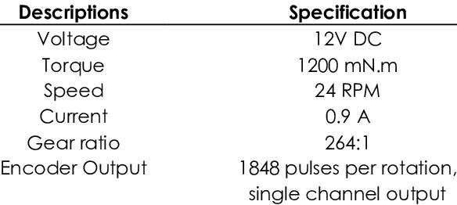
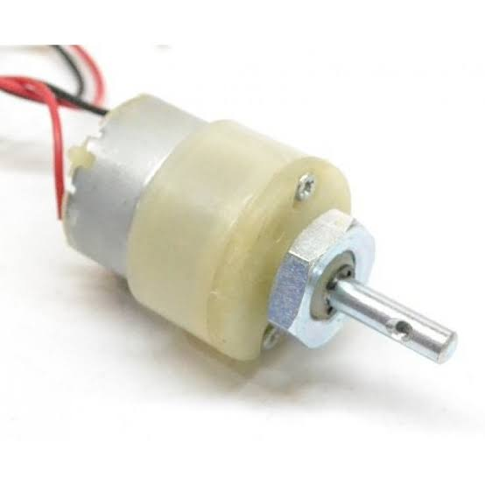
GEAR MOTOR

Slide 17
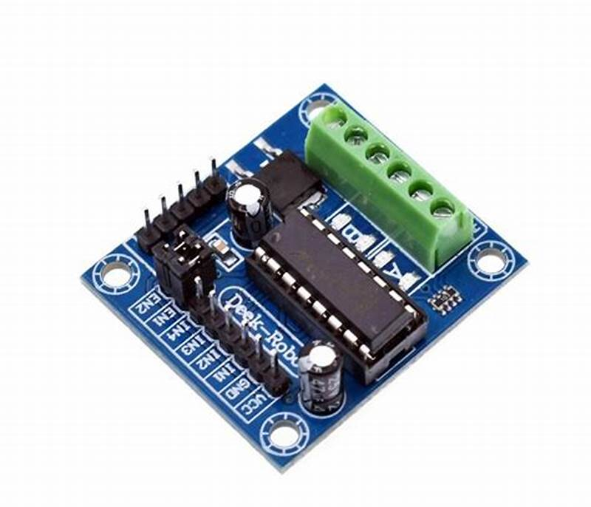
L293 MOTOR DRIVER
Operating voltage : 4.5 V to 36 V
Peak current : 1.2 A
Operating temperature : 0°C – 70°C
It has automatic thermal shutdown
I/P pins : 4

Slide 18
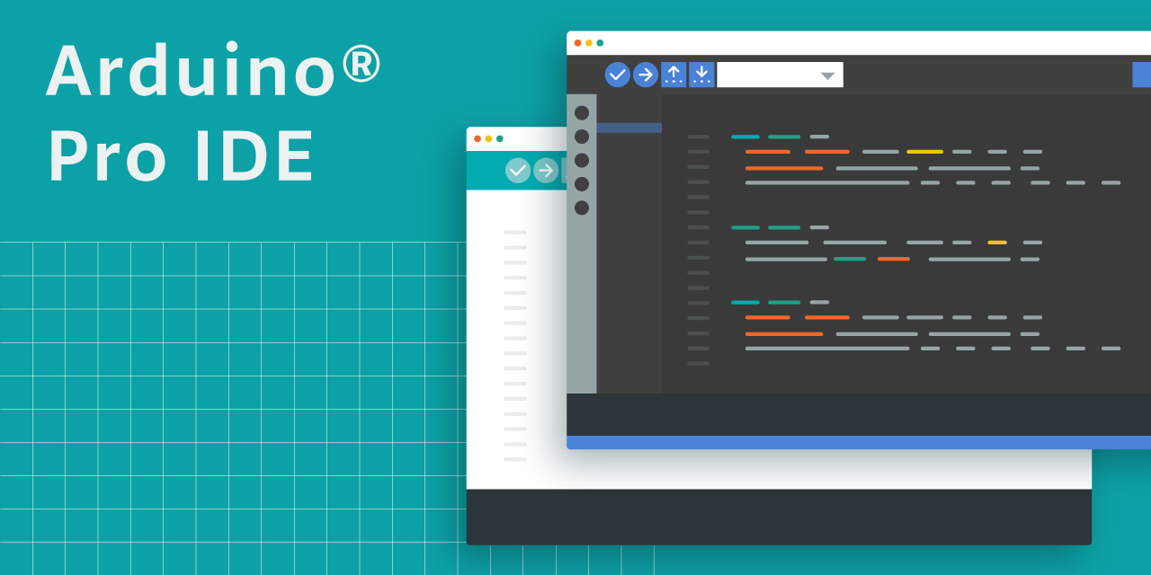
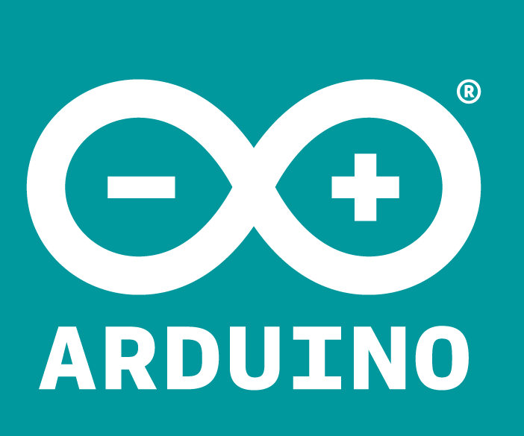
SOFTWARE CAST-OFF

Slide 19
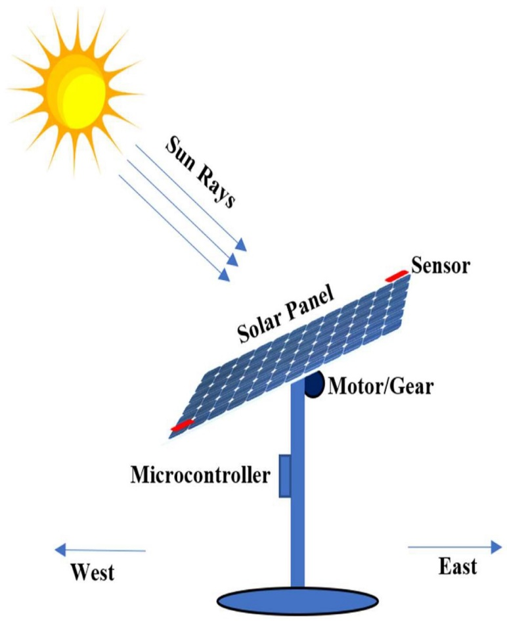
WORKING PRINCIPLE
Sensors detect the sun's position and intensity.
Arduino determines the optimal position.
Micro controller sends commands to motor driver.
Motor driver controls the speed of gear motor.

Slide 20
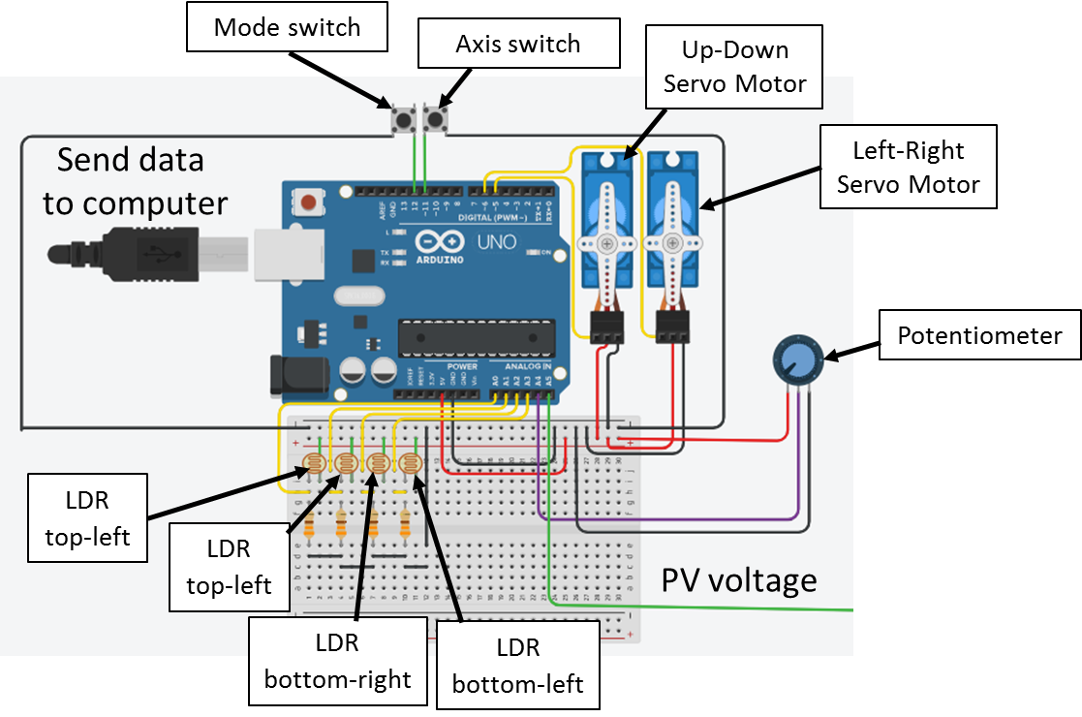
SCHEMATIC DIAGRAM

Slide 21
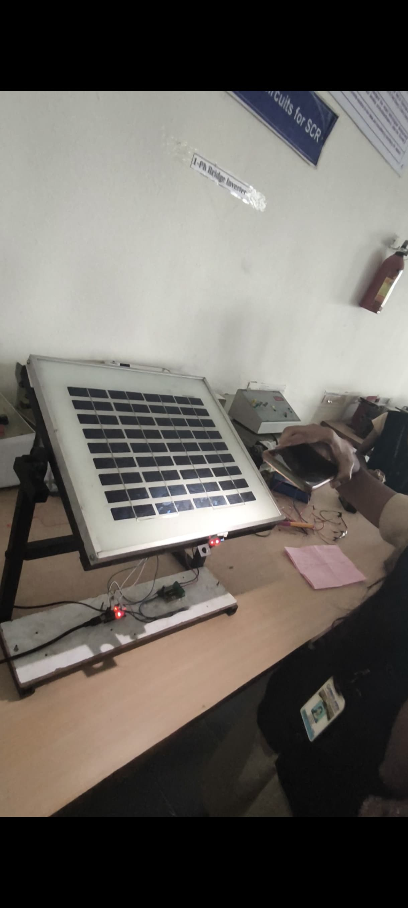
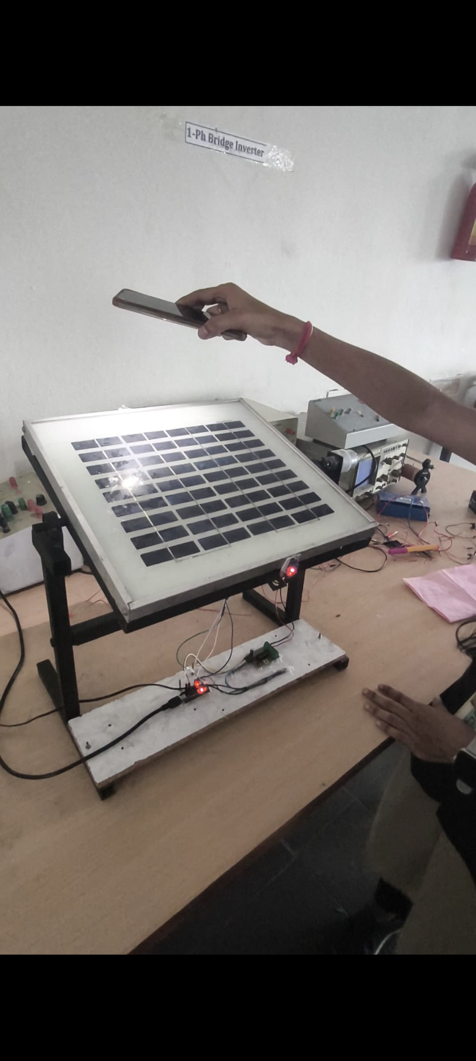
OUTPUT

Slide 22
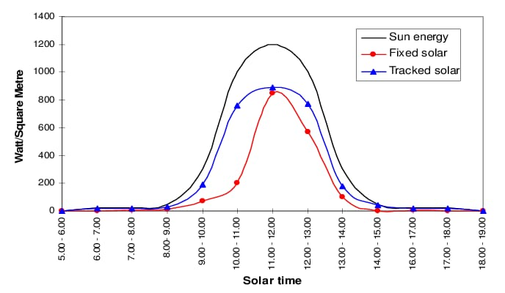
RESULTS

Slide 23
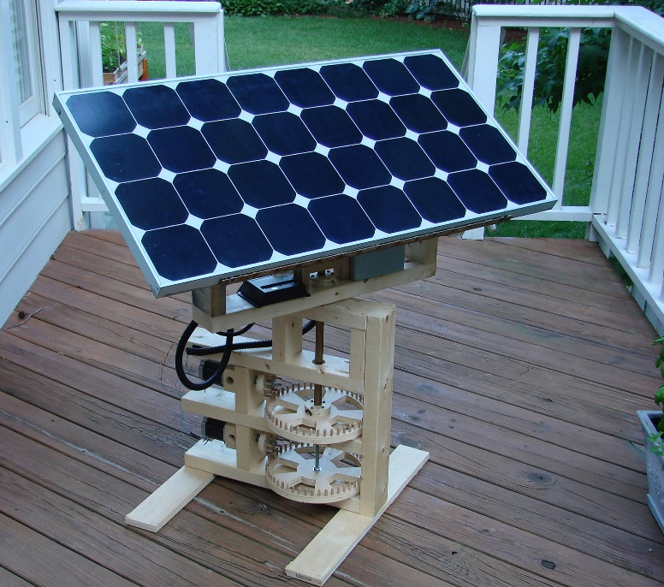
ADVANTAGES
Increased Energy Harvesting
Improved Efficiency
Cost-Effective
Flexibility
Real-time Monitoring
Automation
Precision

Slide 24
DISADVANTAGES
Limited Power Handling
Weather Interference
Maintenance Requirements
Limited Scalability
Dependence on Sensors
Power Consumption

Slide 25

APPLICATIONS
Solar Power Generation
Water Pumping
Street Lighting
Greenhouses
Solar Still

Slide 26
CONCLUSION
The innovative designs in sun tracking systems have enabled the development of many solar thermal and photovoltaic systems for a diverse variety of applications in recent years compared to the traditional fixed panels.

Slide 27
FUTURE SCOPE
The future scope of Arduino-based solar tracking systems is promising due to increasing demand for renewable energy solutions and advancements in technology. Here are several potential directions for their development and application:
Increased efficiency
Hybrid systems
Microgrid applications

Slide 28


Slide 29
